Slide 1
UCF439 Capstone Project “Network Analyzer “ Group No - 90
Supervisor Name:
Mrs.Vishakha Arya
Supervisor Email:
vishakha.arya@dituniversity.edu.in
Student’s name:
Jaiveer Singh Parihar(1000016075)
Prince Raj(1000016311)
Surakshit chauhan(1000016220)

Slide 2
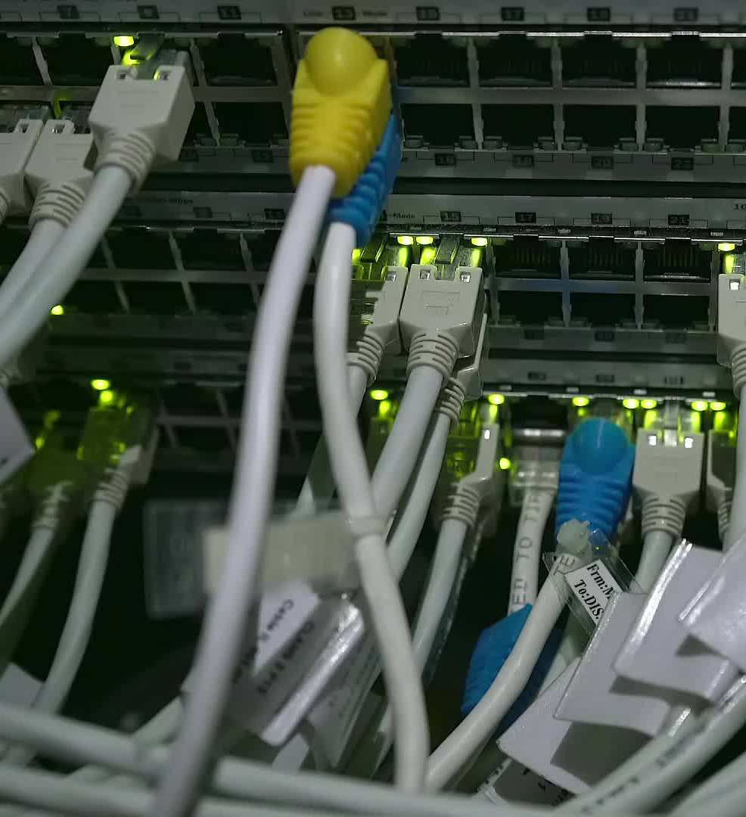
Introduction
The Network Security Analyzer is a Python-based tool designed to analyze network traffic, detect potential security threats, and provide insights into network behavior. It integrates various networking and security techniques to identify connected devices, monitor traffic patterns, detect rogue devices, analyze DNS activity, and safeguard against common cyber threats such as ARP spoofing, DNS poisoning, and SYN flood attacks.
The tool is particularly useful for:
Cybersecurity professionals who need to monitor and secure networks
Network administrators responsible for network health and intrusion detection
Students and researchers studying network security and ethical hacking

Slide 3

Problem Statement
In today's digital landscape, cyber threats such as malware, phishing attacks, unauthorized access, and Distributed Denial-of-Service (DDoS) attacks are rapidly increasing. Traditional network security tools often struggle with high false positives, limited automation, and a lack of real-time anomaly detection, making it difficult for security teams to respond efficiently.
Many existing solutions, such as Wireshark and Snort, primarily focus on packet analysis but lack comprehensive automated threat detection.

Slide 4

Problem Statement
To address these challenges, this project aims to develop a Network Security Analyzer that: ✔ Monitors network traffic in real-time ✔ Detects rogue devices and security vulnerabilities ✔ Identifies malicious patterns and prevents attacks proactively ✔ Reduces false positives through better threat analysis ✔ Automates reporting for faster incident response
.

Slide 5

Background / Related Work
With the rise of cyber threats such as malware infections, DDoS attacks, DNS spoofing, and unauthorized access, advanced security tools are essential. Existing solutions like Wireshark and Snort focus on packet analysis but lack comprehensive automated real-time threat detection and reporting. Our tool goes beyond simple packet capture, offering real-time rogue device detection, DNS spoofing mitigation, and an automated security reporting system, reducing false positives and improving response times.

Slide 6
Feasibility Study
1. Technical Feasibility
Implemented using Python with Scapy for packet capture and Pandas for data processing.
Uses threading for efficient multitasking.
Integrates NetworkX for network graph visualization.
Utilizes Netifaces for interface scanning and requests for network communication.
2. Operational Feasibility
Designed for network administrators and security analysts for efficient traffic monitoring.
Features a user-friendly interface, making it accessible to non-technical users.
Useful for cybersecurity training and educational purposes.

Slide 7

Feasibility Study
3. Economic Feasibility
Open-source, eliminating licensing costs.
Runs on standard machines without requiring additional hardware.
Offers a cost-effective solution for network monitoring.

Slide 8
Project Description:
The Network Security Analyzer has been developed with the following completed functionalities:
Network Discovery & Host Identification
Uses ARP scanning to detect active devices on the network.
Extracts IP addresses, MAC addresses, and vendor details.
Retrieves network configuration details
Traffic Monitoring & Packet Capture
Captures network packets in real-time using scapy.
Supports TCP, UDP, and DNS traffic monitoring.
Saves captured packets to PCAP files for forensic analysis.

Slide 9
Project Description:
.
Security Threat Detection
Detects rogue devices by comparing active hosts with a list of known
devices.
Identifies unauthorized access points in a WiFi network.
Implements DNS spoofing detection by comparing DNS query results with trusted servers.
Monitors for SYN flood attacks by tracking SYN packets.
CLI-Based User Interface
Provides an interactive command-line menu for ease of use.
Allows users to configure scanning options and save results.
Implements error handling and logging.

Slide 10
Remaining Work:
Report Generation – Create CSV and TXT reports for security logs.
Improve Threat Detection – Enhance accuracy and reduce false alerts.
Optimize Performance – Speed up scans and reduce system resource usage.
Final Testing & Debugging – Find and fix bugs, test in different networks.
Documentation & Deployment – Write user guides and finalize for release.

Slide 11
Project Timeline
Week | Task
Week 1 – 2 | Define project scope & objectives. Research cybersecurity threats & existing network security tools.
Week 3 – 5 | Extract IP, MAC addresses & vendor details. Develop real-time packet sniffing (TCP, UDP, DNS).
Week 6 -7 | Develop DNS spoofing detection using trusted server comparisons.

Slide 12
Conclusion
The Network Analyzer provides a structured approach for network monitoring and security analysis.
The tool combines multiple features—packet capturing, visualization, logging, and reporting—into one.
Future developments will enhance usability, efficiency, and automation capabilities.
Will help organizations and individuals secure their networks and improve performance.

